Slide 1
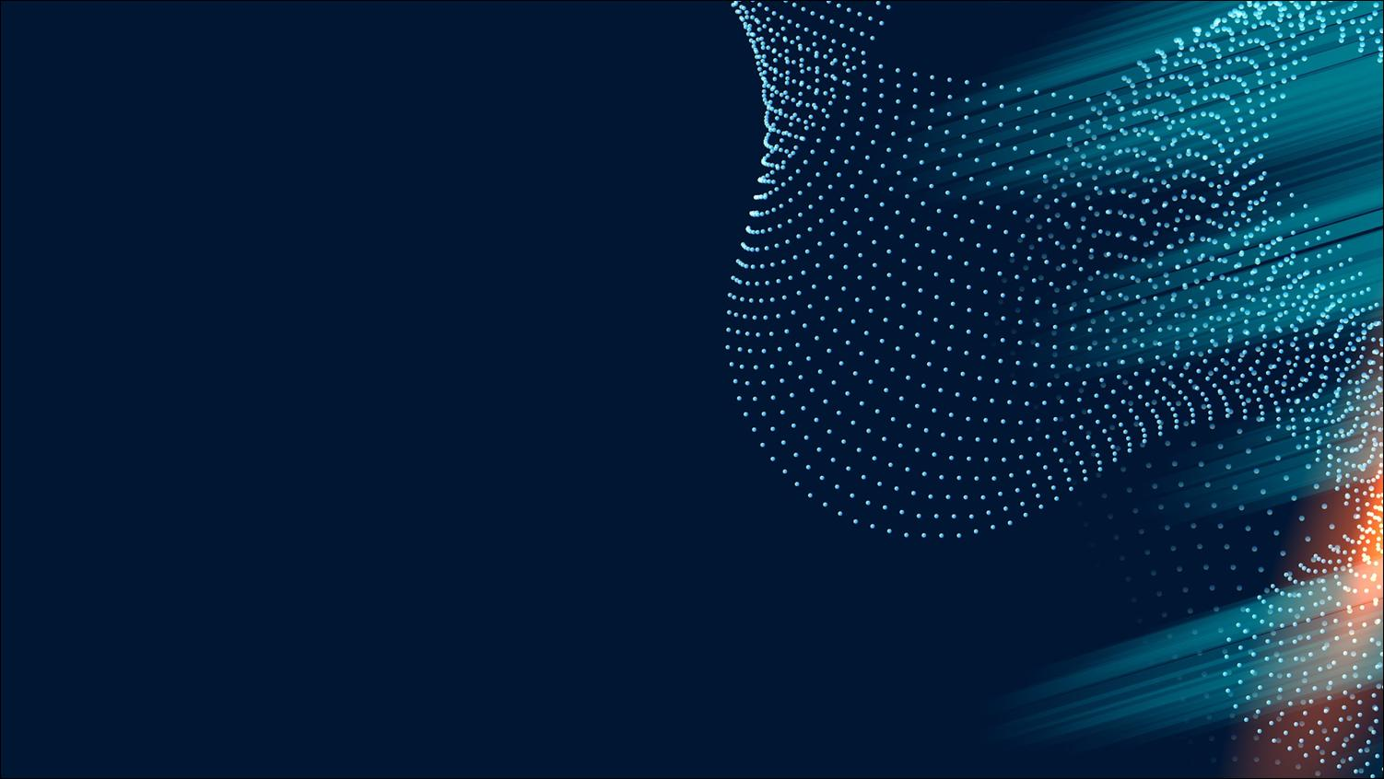

Title: Advanced Deep Learning Methods for Early Detection and Progressive Classification of Cervical Cancer
Paper ID: 327
Presented by: Keshav Handa
4th International Conference on Artificial Intelligence and Signal Processing (AISP 2024)
26-28 October 2024
VIT-AP University

Slide 2
INTRODUCTION
Cervical Cancer Background:
Fourth most common cancer in women globally, particularly affecting those in low-resource areas.
Early detection critical: treatment success rates are high if detected at early stages.
Limitations of Traditional Screening:
Pap smear tests: Depend on cytologist expertise; interpretation is subjective.
Results vary significantly, affecting reliability (sensitivity and specificity are inconsistent).
Limitations become significant barriers in low-resource areas.
CNNs as a Solution:
Automation of diagnosis minimizes need for manual assessment.
Enables high precision by analyzing complex patterns in cytology images, enhancing accuracy and minimizing errors.

Slide 3
PROBLEM STATEMENT AND MOTIVATION
Problem Statement:
Traditional diagnostic tools (Pap smears) are resource-intensive, relying heavily on skilled personnel.
Variability in results due to subjectivity impacts diagnosis timelines and treatment efficacy.
Limited access in low-resource settings delays diagnosis and compromises patient outcomes.
Motivation for Research:
Develop a reliable, fast, and accurate automated diagnostic tool using CNNs.
Solution aimed at providing universal, resource-friendly screening to improve patient outcomes.
Objective: Facilitate early, precise diagnosis regardless of geographical or resource limitations.

Slide 4
RESEARCH OBJECTIVES
Develop a CNN Model:
Model must detect early signs and classify different stages of cervical cancer, even with limited data availability.
Enhance Model Robustness:
Data augmentation strategies like rescaling, flipping, and zooming increase generalization capabilities.
Ensures model can handle a wide variety of real-world data with accuracy.
Incorporate Transfer Learning:
Pre-trained models (AlexNet and ResNet) minimize data demands.
Transfer learning accelerates model training and optimizes performance on small, medical image datasets.
Expected Outcome:
Achieve a robust, deployable model with potential for real-world clinical application.

Slide 5
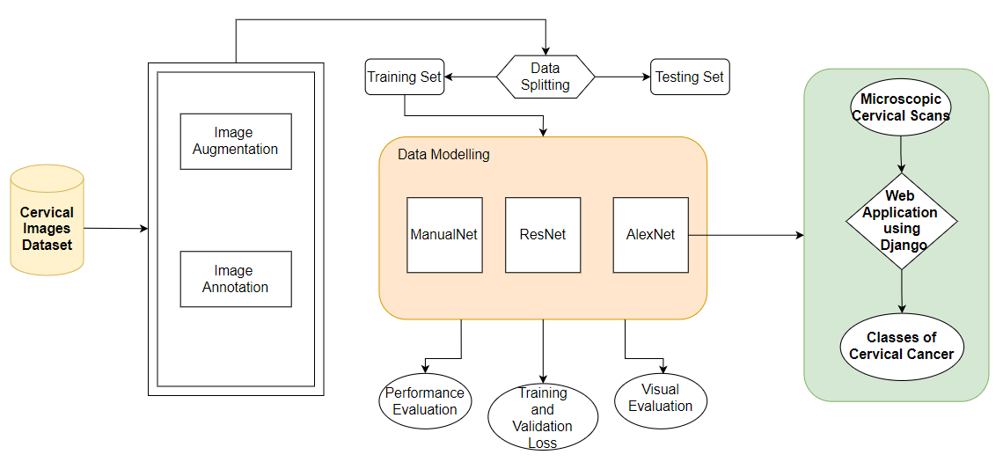
PROPOSED METHODOLOGY

Slide 6
PROPOSED METHODOLOGY
Dataset and Image Sources:
Dataset: 2000 images for training, 1997 for testing.
Image Classifications: Five stages of cervical cancer, providing a balanced set for model training.
Model Architectures:
ManualNet: Custom CNN developed for initial testing; simpler model used as a baseline.
AlexNet: Strong image classification performance; well-suited for transfer learning, widely validated.
ResNet: Employs residual connections for deeper architectures, ideal for high-dimensional medical image analysis.
Data Augmentation:
Techniques include rescaling, zooming, shearing, and flipping to increase dataset variability.
Augmentation simulates real-world conditions, enhancing model generalization.

Slide 7
PROPOSED METHODOLOGY
Regularization Techniques:
Dropout Layers: Prevent overfitting, forcing the model to generalize well across diverse data.
Batch Normalization: Stabilizes training, reduces sensitivity to parameter initialization.
Optimization:
RMSprop Optimizer: Efficient for CNNs, particularly useful with high-dimensional data.
Categorical Cross-Entropy Loss: Optimizes multi-class classification tasks, ideal for this application.

Slide 8
ALEXNET ARCHITECTURE
Core Components:
Convolutional Layers: Five layers extracting hierarchical features (edges, textures, patterns).
Max-Pooling Layers: Reduces spatial dimensions, retains essential features while optimizing memory usage.
Dropout Layers: Randomly removes nodes during training, helping prevent overfitting.
Classification Layer:
Softmax Output: Converts raw outputs into probability distributions over five cervical cancer stages.
Strengths and Suitability for Task:
Effective for feature extraction in high-resolution medical imaging.
Proven performance in various image classification tasks, making it suitable for cytology analysis.

Slide 9
RESNET AND MANUALNET ARCHITECTURE
ResNet Architecture:
Residual Connections: Allows deeper networks to maintain gradient flow, reducing vanishing gradient issues.
Ideal for complex medical image tasks requiring nuanced feature learning, suited for high-dimensional data.
Performs well on smaller datasets when coupled with transfer learning.
ManualNet Architecture:
Custom CNN designed specifically for cervical cancer classification.
Simpler than AlexNet and ResNet, intended for comparison and baseline measurements.
Comparison and Model Rationale:
AlexNet and ResNet leverage transfer learning, yielding superior performance.
ManualNet, while effective for basic testing, struggled with generalization due to lack of pre-trained weights.

Slide 10
TRAINING AND EVALUATION
Data Split: 2000 training images, 1997 test images.
Training Parameters: 100 epochs, batch size of 512.
Optimizer and Loss Function: RMSprop optimizer, categorical cross-entropy loss.
Training Observations:
AlexNet achieved consistent improvement in both training and validation accuracy.
ResNet demonstrated strong performance, though with longer training times due to depth.
ManualNet showed limitations in generalization, highlighting the benefits of transfer learning in AlexNet and ResNet.

Slide 11
EXPERMINENTAL RESULTS
Model Performance Summary:
AlexNet: Training accuracy of 91.25%, precision of 92.51%, validation accuracy of 86.04%.
ResNet: Achieved 88.5% accuracy after 100 epochs.
ManualNet: Reached peak accuracy of 63%, but generalization was limited.
Conclusions Based on Results:
AlexNet offered the best balance between accuracy and generalization, making it suitable for clinical applications.
ResNet demonstrated depth-based advantages, but AlexNet’s efficiency made it more practical for this dataset.
ManualNet served as a useful baseline but was outperformed by models leveraging transfer learning.

Slide 12
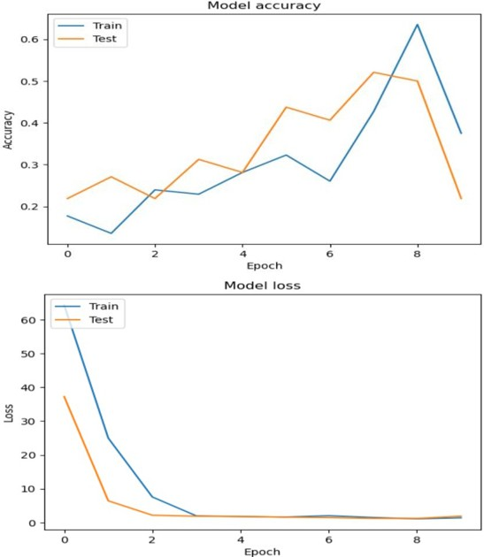
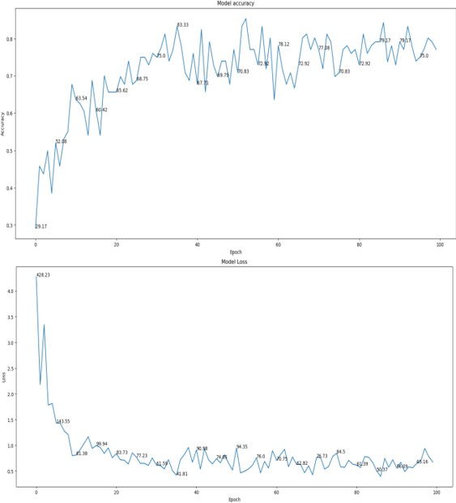
EXPERMINENTAL RESULTS
Accuracy and Loss of ManualNet Model
Accuracy and Loss Graph of ResNet Model

Slide 13
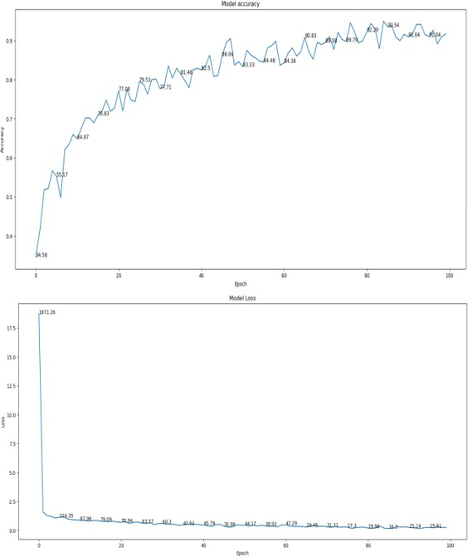
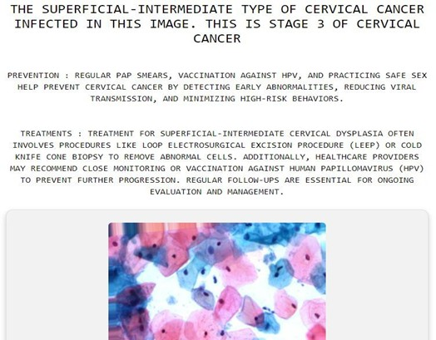
EXPERMINENTAL RESULTS
Accuracy and Loss Graph of AlexNet Model
Cervical Cancer Detection and Classification website

Slide 14
CONCLUSION
AlexNet’s deep architecture successfully distinguishes between cancer stages, making it a strong candidate for real-world applications.
Transfer learning minimized the need for large datasets and shortened training times, beneficial for medical image tasks with limited data.
Clinical Relevance:
Deploying this model in clinical settings could support early-stage detection, enabling timely and accurate interventions.
Potential to enhance diagnostic workflows in low-resource settings, improving accessibility to early diagnosis.
Impact and Future Potential:
This research illustrates the potential of CNNs, particularly AlexNet, to enhance cervical cancer detection and classification accuracy.

Slide 15
FUTURE WORK
Expand dataset to include a wider range of images from various demographics and sources, enhancing model generalization.
Utilize Generative Adversarial Networks (GANs) to generate synthetic images, addressing data scarcity and class imbalance.
Clinical Testing and Goal:
Real-world deployment in clinical environments to validate the model’s effectiveness and reliability in practical settings.
Revolutionize cervical cancer screening by providing a scalable, reliable, and accurate early detection tool to improve patient outcomes globally.

Slide 16
THANK YOU

